Slide 1

GROUP 29
Analyzing Social Media Posts for Mental Health Disorder Detection
ROLL NUMBER | NAME
13000121033 | SOUMYADEEP NANDY
13000121037 | PRITHWISH SARKAR
13000121040 | SAGNIK MUKHOPADHYAY
13000121058 | ARKAPRATIM GHOSH
PROJECT-III ( PROJ-CS881 )
CSE : SEMESTER 8

Slide 2

CONTENT
GR29 ANALYZING SOCIAL MEDIA POSTS FOR MENTAL HEALTH DISORDER DETECTION
Motivation
Introduction
Research Work
Problem Definition
Proposed Workflow
Implementation
Results and Analysis
Prototype
Conclusion
References

Slide 3
MOTIVATION
GR29 ANALYZING SOCIAL MEDIA POSTS FOR MENTAL HEALTH DISORDER DETECTION
Rising global concern over mental health disorders : Mental health issues are affecting millions worldwide, requiring urgent attention.
Social media is a key outlet for emotional expression : Platforms like Twitter and Reddit reveal mental health struggles in real-time.
Early detection of mental health issues can save lives : Identifying mental health disorders early helps provide timely interventions.
Machine learning can automate detection of mental health disorders : Technology enables efficient analysis of large social media data for early warning signs.
Potential to assist mental health professionals and organizations : Provides valuable insights for mental health monitoring and public health efforts.
Opportunity to improve mental health awareness on social platforms Can support campaigns that foster awareness and reduce stigma online.
Lack of a publicly available application which incorporates text, image, video, audio, emotions and situations derived from images/frames for overall mental issue classification and corresponding wellbeing mapping.

Slide 4
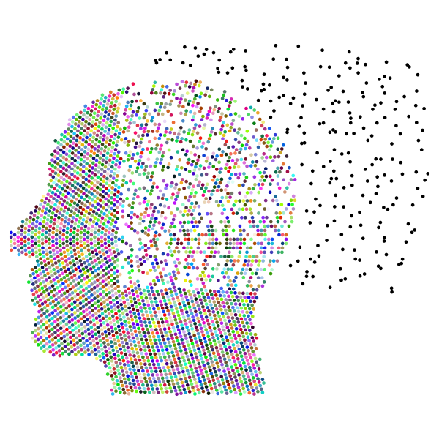
INTRODUCTION
GR29 ANALYZING SOCIAL MEDIA POSTS FOR MENTAL HEALTH DISORDER DETECTION
Role of social media in mental health expression : People share emotions, struggles, and experiences on platforms like Twitter and Reddit.
Goal of the project : To detect mental health disorders early through the analysis of social media posts (text and image) or by uploading images, videos, facial expression recognition, generating image captions ,manually inserting text and retrain model in the process.
Leveraging machine learning : Using advanced techniques like NLP and classification models to analyze text normally posted, extracted from image, audio and video.

Slide 5

INTRODUCTION (CONTINUED)
GR29 ANALYZING SOCIAL MEDIA POSTS FOR MENTAL HEALTH DISORDER DETECTION
Focus on text classification for the base model : Analyzing language patterns to classify posts related to mental health issues.
Impact of early detection : Can enable timely intervention and direct users to mental health support services.
Models used in the project : Techniques like Logistic Regression, XGBoost, Transformers are applied for high accuracy. Ensemble Model using the individual models is created to get higher accuracy and generalization.
Broader goal : Use technology to assist mental health professionals and enhance public health awareness.

Slide 6
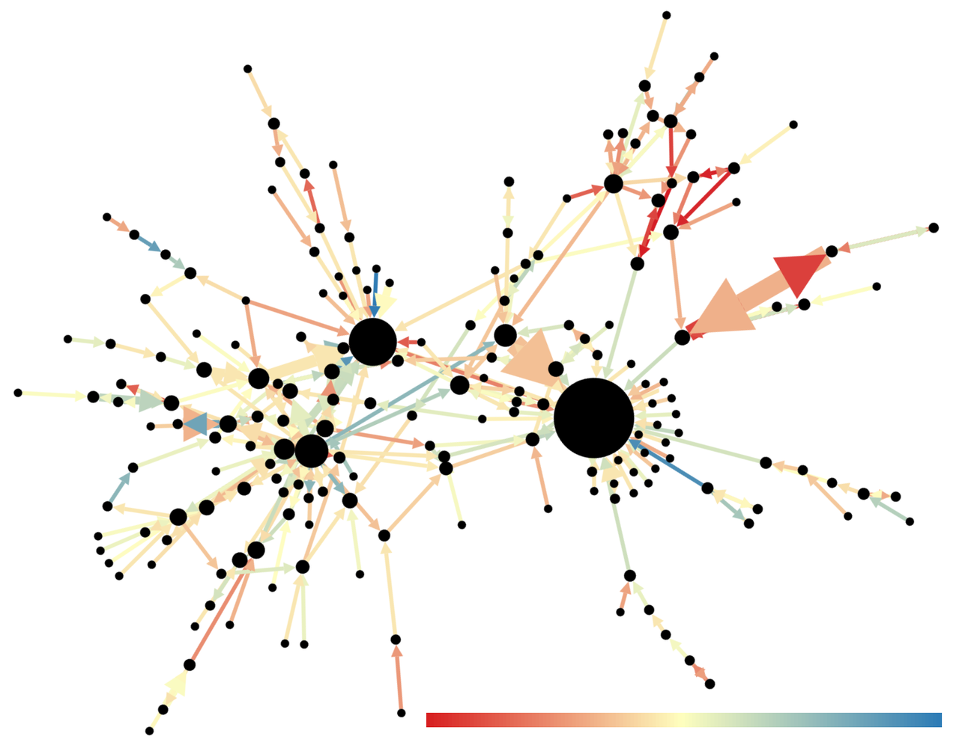
RESEARCH WORK
GR29 ANALYZING SOCIAL MEDIA POSTS FOR MENTAL HEALTH DISORDER DETECTION
Social media and mental health research Explored studies on how social media data can reveal mental health conditions.
Key study by Choudhury et al. (2013) Showed the predictive power of Twitter data in identifying depression through linguistic patterns.
Guntuku et al. (2017) review Synthesized various approaches to detecting mental illness using sentiment analysis on social platforms.
Mathur et al. (2022) systematic review Highlighted the success of machine learning techniques in detecting disorders like depression and anxiety.

Slide 7
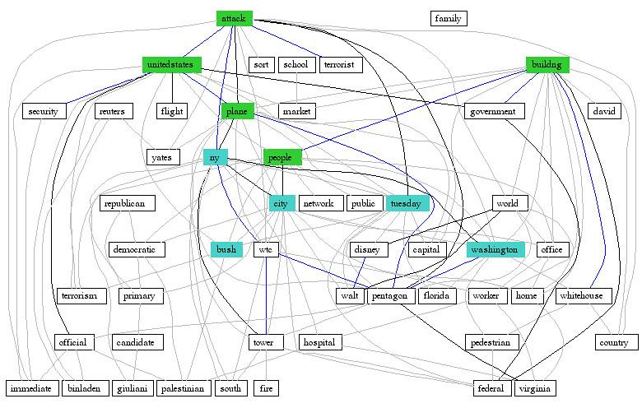
RESEARCH WORK (CONTINUED)
GR29 ANALYZING SOCIAL MEDIA POSTS FOR MENTAL HEALTH DISORDER DETECTION
Nadeem (2016) study on Twitter Demonstrated the potential of text analysis to identify at-risk individuals based on emotional cues in tweets.
Al Sagri and Ykhlef (2020) approach Combined linguistic and behavioral features for more accurate depression detection on Twitter.
Recent study by Vaishnavi et al. (2022) Comparative analysis of algorithms to identify mental health conditions from social media posts.
Ethical considerations by Safa et al. (2023) Addressed data privacy challenges in mental health detection research using social media data.

Slide 8

PROBLEM DEFINITION
GR29 ANALYZING SOCIAL MEDIA POSTS FOR MENTAL HEALTH DISORDER DETECTION
Rising prevalence of mental health disorders : Increasing cases of depression, anxiety, PTSD, and other mental health issues globally.
Challenges in early detection : Mental health problems are often undiagnosed until advanced stages, limiting timely intervention.
Vast amount of unstructured social media data : Social media platforms generate large volumes of text that can indicate mental health struggles.
Need for efficient detection methods : Manual analysis of social media posts is time-consuming; automation using machine learning is essential.
Goal : To develop a system that accurately classifies social media posts based on mental health disorders.

Slide 9
PROPOSED WORKFLOW
GR29 ANALYZING SOCIAL MEDIA POSTS FOR MENTAL HEALTH DISORDER DETECTION
Data Collection : Collect Reddit posts using the PRAW API and extract labeled data for mental health categories like Normal, Anxiety, Depression, PTSD, and Bipolar.
Data Preprocessing : Clean the collected data by removing URLs, stopwords, and special characters. Normalize and tokenize the text, followed by converting it into numerical formats ( TF-IDF, Bag Of Words, Word2Vec, LIWC, N-Gram ) for analysis.
Model Training and Evaluation :Train machine learning models including Logistic Regression, Naive Bayes, SVM, Random Forest, XGBoost, KNN, LSTM and Transformers. Evaluate their performance using metrics such as accuracy, precision, recall, and F1-score. Apply Hyperparameter Tuning on ML models as needed to improve the accuracy further. Leverage Ensemble Learning with multiple models to get higher accuracy.
Testing and Deployment : Test the best-performing models and deploy them on a user-friendly interface using Streamlit. Ensure the system supports real-time classification for various inputs.like text, image, video, audio and user profiles from social media platforms like Reddit and Twitter.

Slide 10
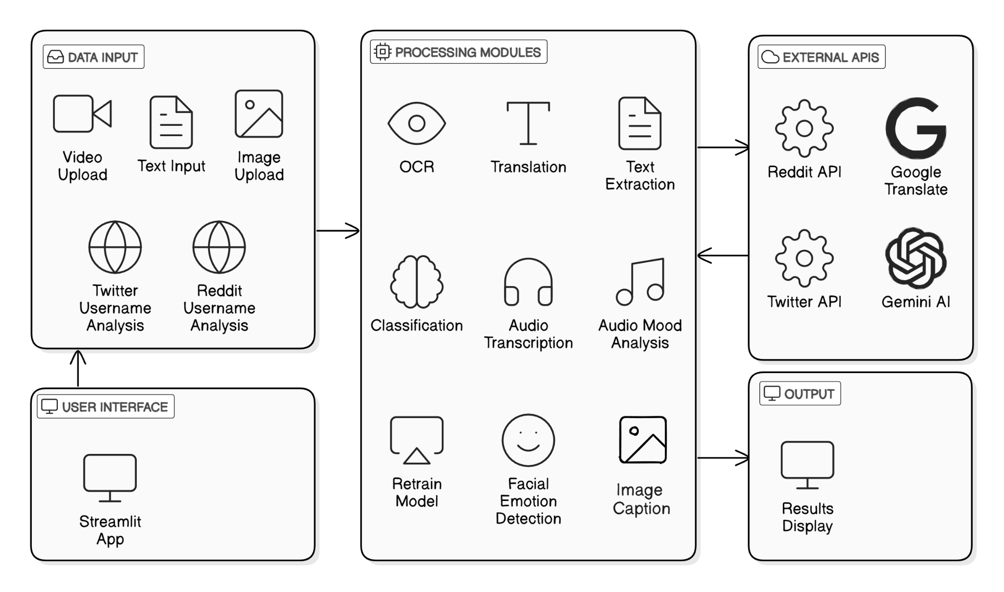
PROPOSED WORKFLOW (CONTINUED)
GR29 ANALYZING SOCIAL MEDIA POSTS FOR MENTAL HEALTH DISORDER DETECTION
SYSTEM OVERVIEW

Slide 11
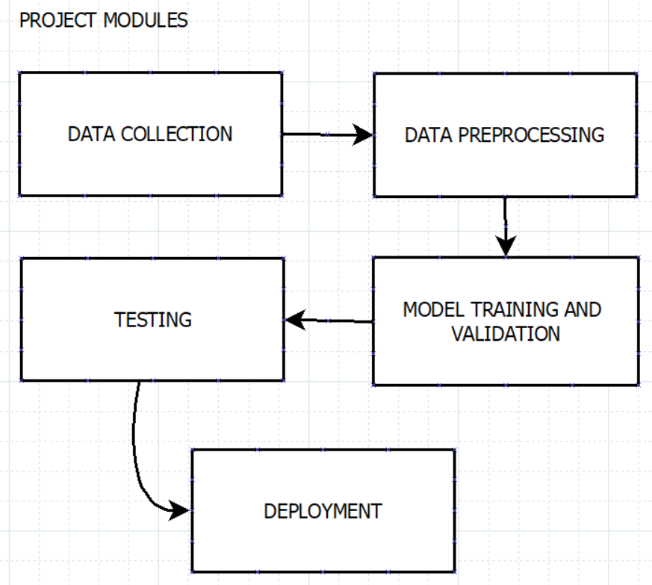
PROPOSED WORKFLOW (CONTINUED)
GR29 ANALYZING SOCIAL MEDIA POSTS FOR MENTAL HEALTH DISORDER DETECTION

Slide 12
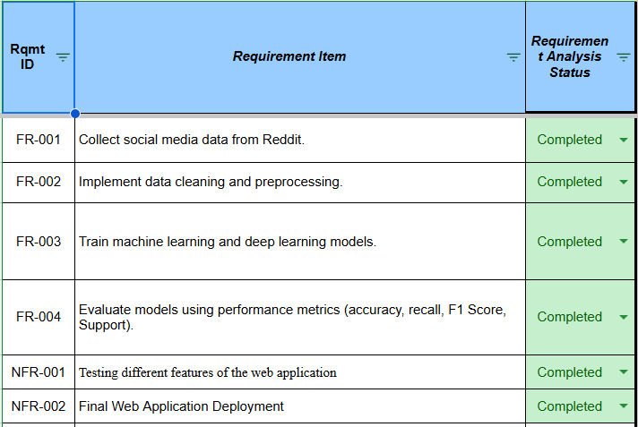
IMPLEMENTATION
GR29 ANALYZING SOCIAL MEDIA POSTS FOR MENTAL HEALTH DISORDER DETECTION
Data Collection : Scraped Reddit posts related to mental health issues and for analysis.
Data Preprocessing : Cleaned and normalized the text by removing URLs, stop-words, punctuation, and applied tokenization and lemmatization techniques.
Feature Extraction : Utilized Bag of Words, Term Frequency-Inverse Document Frequency (TF-IDF), Word2Vec, LIWC, N-Gram to convert text into numerical format for machine learning models.
Splitting the Dataset : Divided the dataset into training and testing sets to train models and evaluate their performance. Also applied Stratified K-fold Cross Validation
FUNCTIONAL REQUIREMENTS

Slide 13
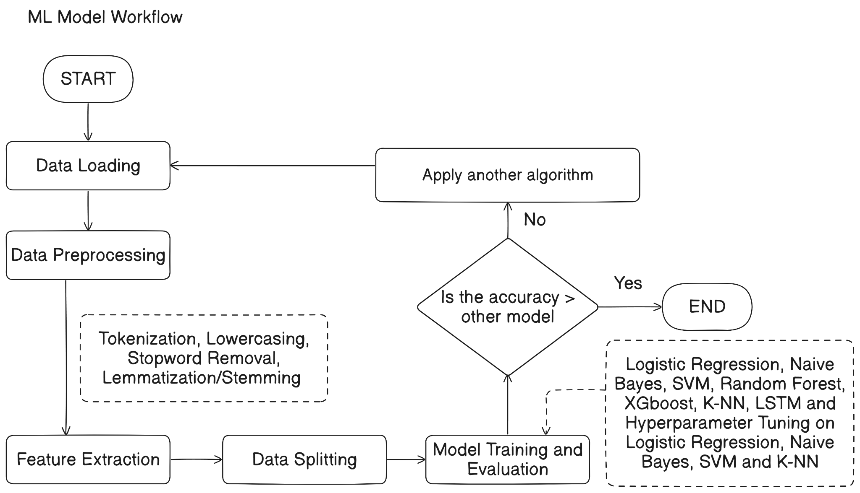
IMPLEMENTATIONS (CONTINUED)
GR29 ANALYZING SOCIAL MEDIA POSTS FOR MENTAL HEALTH DISORDER DETECTION
Model Training : Trained multiple models: Logistic Regression, k-Nearest Neighbors (k-NN), Support Vector Machine (SVM), Naive Bayes, Random Forest, XGBoost, Long Short Term Memory, Transformer and Ensemble Models.
Hyperparameter Tuning : Applied RandomizedSearchCV to optimize the performance of some models.
Model Evaluation : Used metrics like accuracy, precision, recall, F1-score, and confusion matrices to evaluate model effectiveness.
Prediction and Deployment : Implemented the best-performing model for predicting mental health issues from social media posts and deployed using Google Colab, Pyngrok and Streamlit.
MODEL WORKFLOW

Slide 14
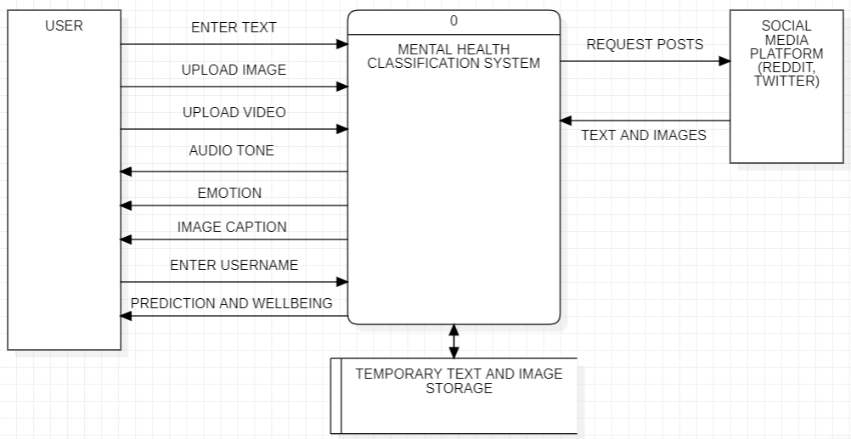
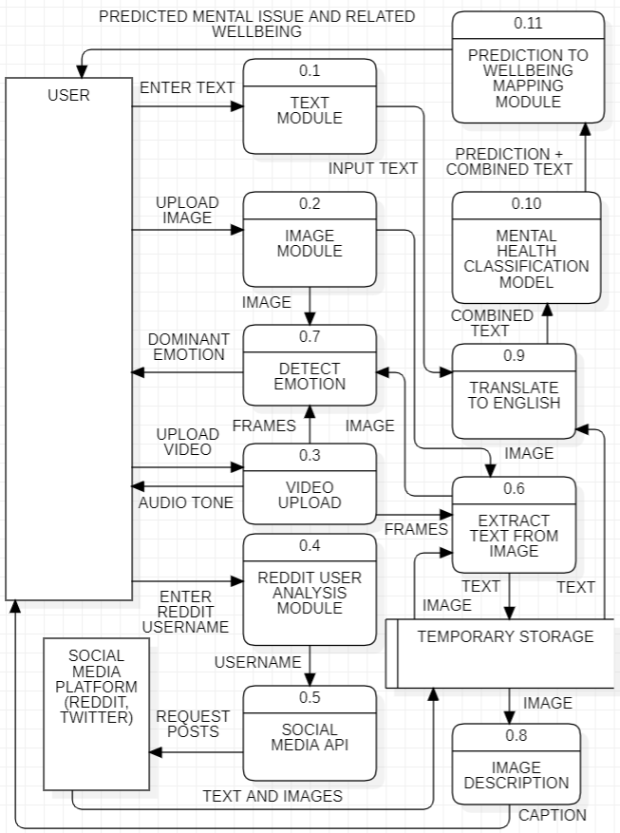
IMPLEMENTATION (CONTINUED)
GR29 ANALYZING SOCIAL MEDIA POSTS FOR MENTAL HEALTH DISORDER DETECTION
DFD LEVEL 0
DFD LEVEL 1

Slide 15
RESULTS AND ANALYSIS
GR29 ANALYZING SOCIAL MEDIA POSTS FOR MENTAL HEALTH DISORDER DETECTION
Logistic Regression : Achieved consistent performance with high accuracy. Precision and recall indicate reliable classification for balanced datasets.
Naive Bayes : Performed well with text data, especially for independent features. Precision was slightly lower for imbalanced classes but remained effective overall. Got better performance after applying hyperparameter tuning.
Support Vector Machine (SVM) : Delivered high accuracy for nonlinear classification tasks. The model showed robustness with complex feature interactions.
Random Forest : Provided strong classification performance with reduced overfitting. Achieved balanced precision and recall across all mental health classes.
XGBoost : Delivered the highest accuracy and efficiency. The model demonstrated excellent handling of imbalanced datasets with robust predictions.
LSTM : Outperformed traditional methods for sequential data. Captured contextual and temporal information effectively, achieving competitive results with complex text patterns.
Transformer : Gave the highest accuracy when implemented separately. Used in Ensemble Learning and improved the overall accuracy of the final model.
K-nearest Neighbours : Performed poorly and gave the worst accuracies among all.

Slide 16
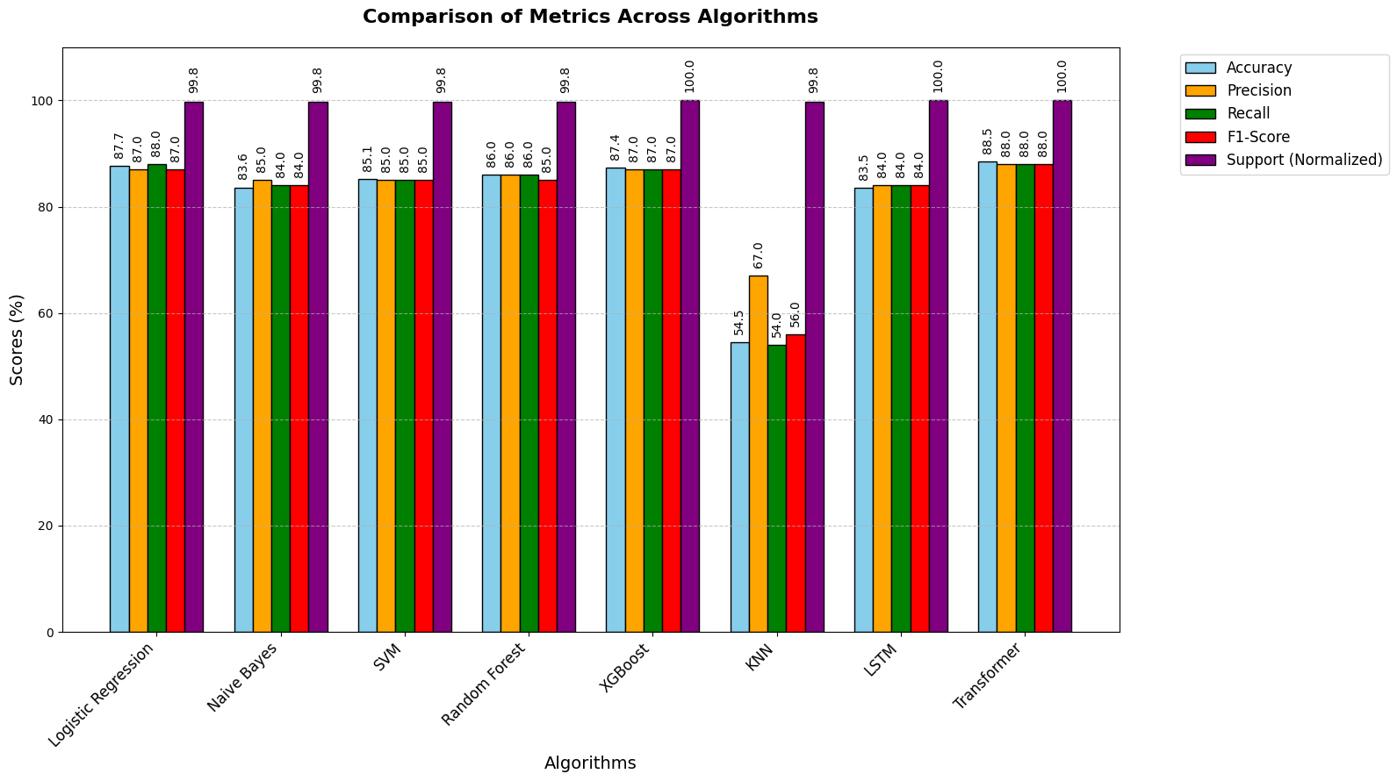
RESULTS AND ANALYSIS (CONTINUED)
GR29 ANALYZING SOCIAL MEDIA POSTS FOR MENTAL HEALTH DISORDER DETECTION
RESULT COMPARISON OF DIFFERENT MODELS

Slide 17
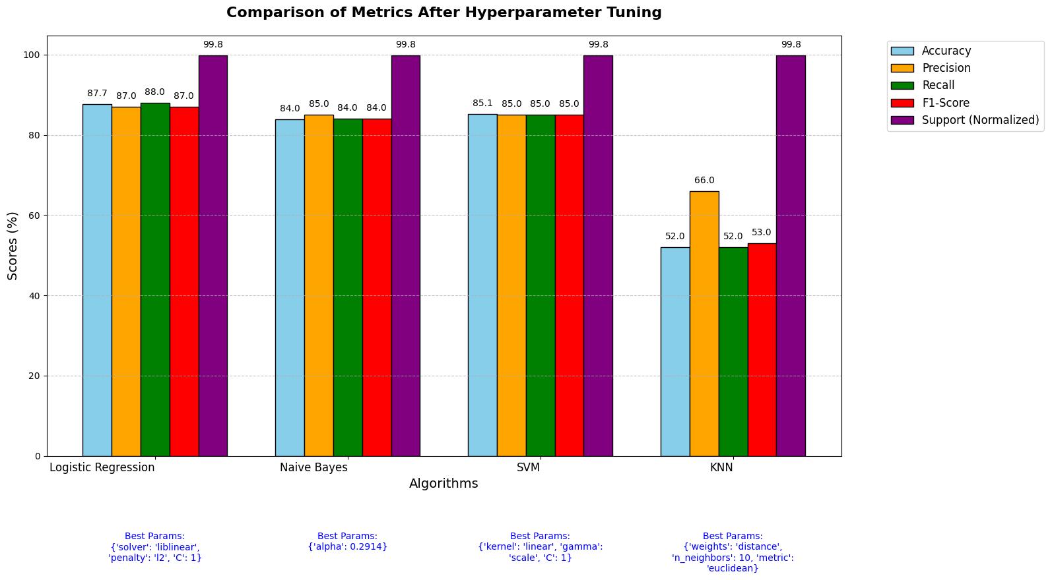
RESULTS AND ANALYSIS (CONTINUED)
GR29 ANALYZING SOCIAL MEDIA POSTS FOR MENTAL HEALTH DISORDER DETECTION
RESULT COMPARISON OF DIFFERENT MODELS AFTER HYPERPARAMETER TUNING

Slide 18
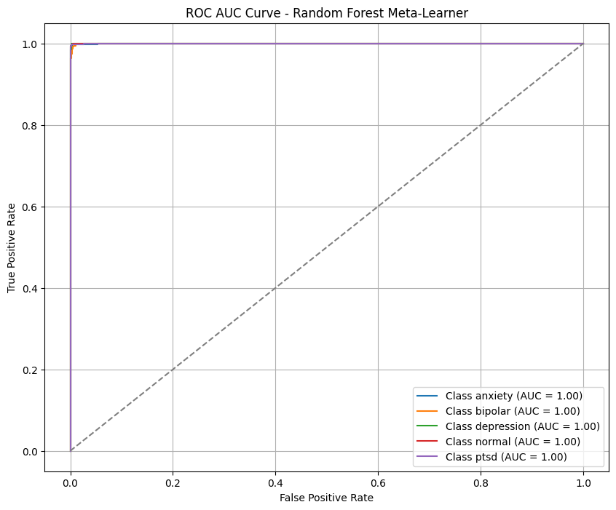
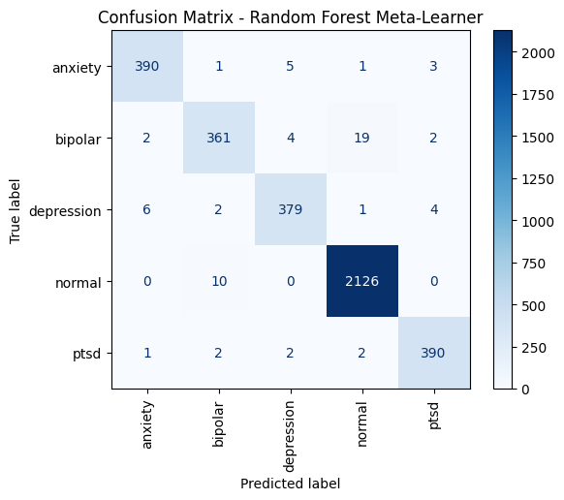
RESULTS AND ANALYSIS (CONTINUED)
GR29 ANALYZING SOCIAL MEDIA POSTS FOR MENTAL HEALTH DISORDER DETECTION
ROC AUC CURVE
CONFUSION MATRIX
ENSEMBLE MODEL (BASE MODELS : LOGISTIC REGRESSION, NAIVE BAYES, SVM, XGBOOST, LSTM, TRANSFORMER & META LEARNER : RANDOM FOREST) WITH ACCURACY OF 98.03% WAS USED IN WEB APPLICATION

Slide 19
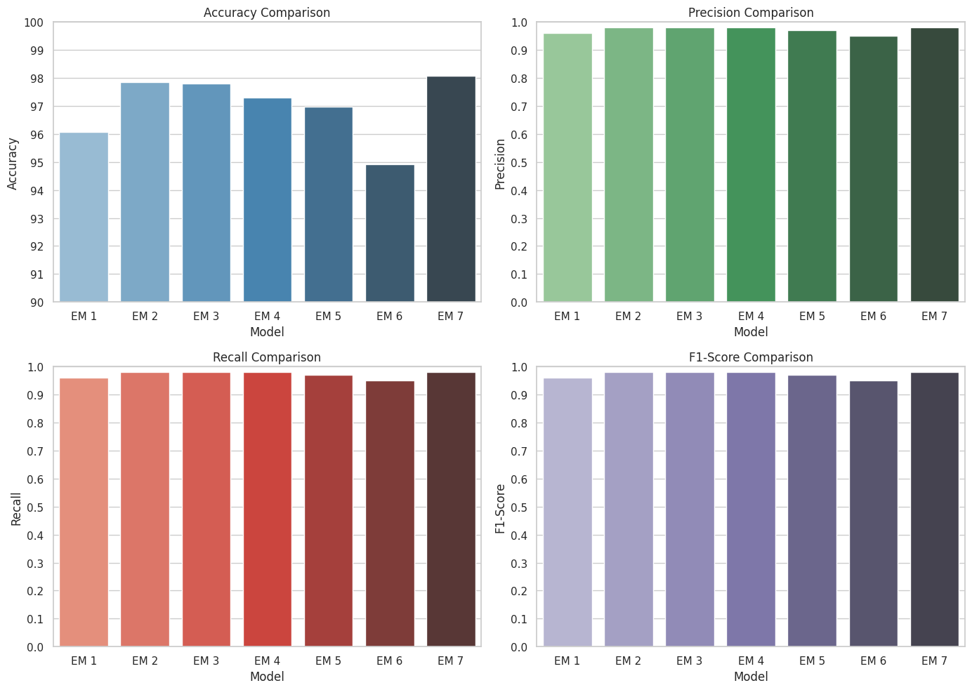
RESULTS AND ANALYSIS (CONTINUED)
GR29 ANALYZING SOCIAL MEDIA POSTS FOR MENTAL HEALTH DISORDER DETECTION
COMPARISON OF DIFFERENT ENSEMBLE MODELS

Slide 20
PROTOTYPE
GR29 ANALYZING SOCIAL MEDIA POSTS FOR MENTAL HEALTH DISORDER DETECTION
Text Classification : Users can directly input text for immediate analysis and classification.
Image-based Classification : Extracts text from uploaded images using OCR (pytesseract), get captions and facial emotions to classify the content.
Video-based Classification : Processes uploaded video files, extract text from frames, transcribes speech to text, get captions and facial emotions to classify the content.
Userprofile Analysis : Enables analysing user profiles based on posts in Reddit and Twitter
A functional prototype was developed to classify mental health concerns from social media posts.
The system allows users to input text, upload images, or submit video for classification.
Key functionalities include text preprocessing, feature extraction, and prediction using trained machine learning models.
Real-time results display the most probable mental health concern with confidence scores.
Allow user to retrain model.

Slide 21
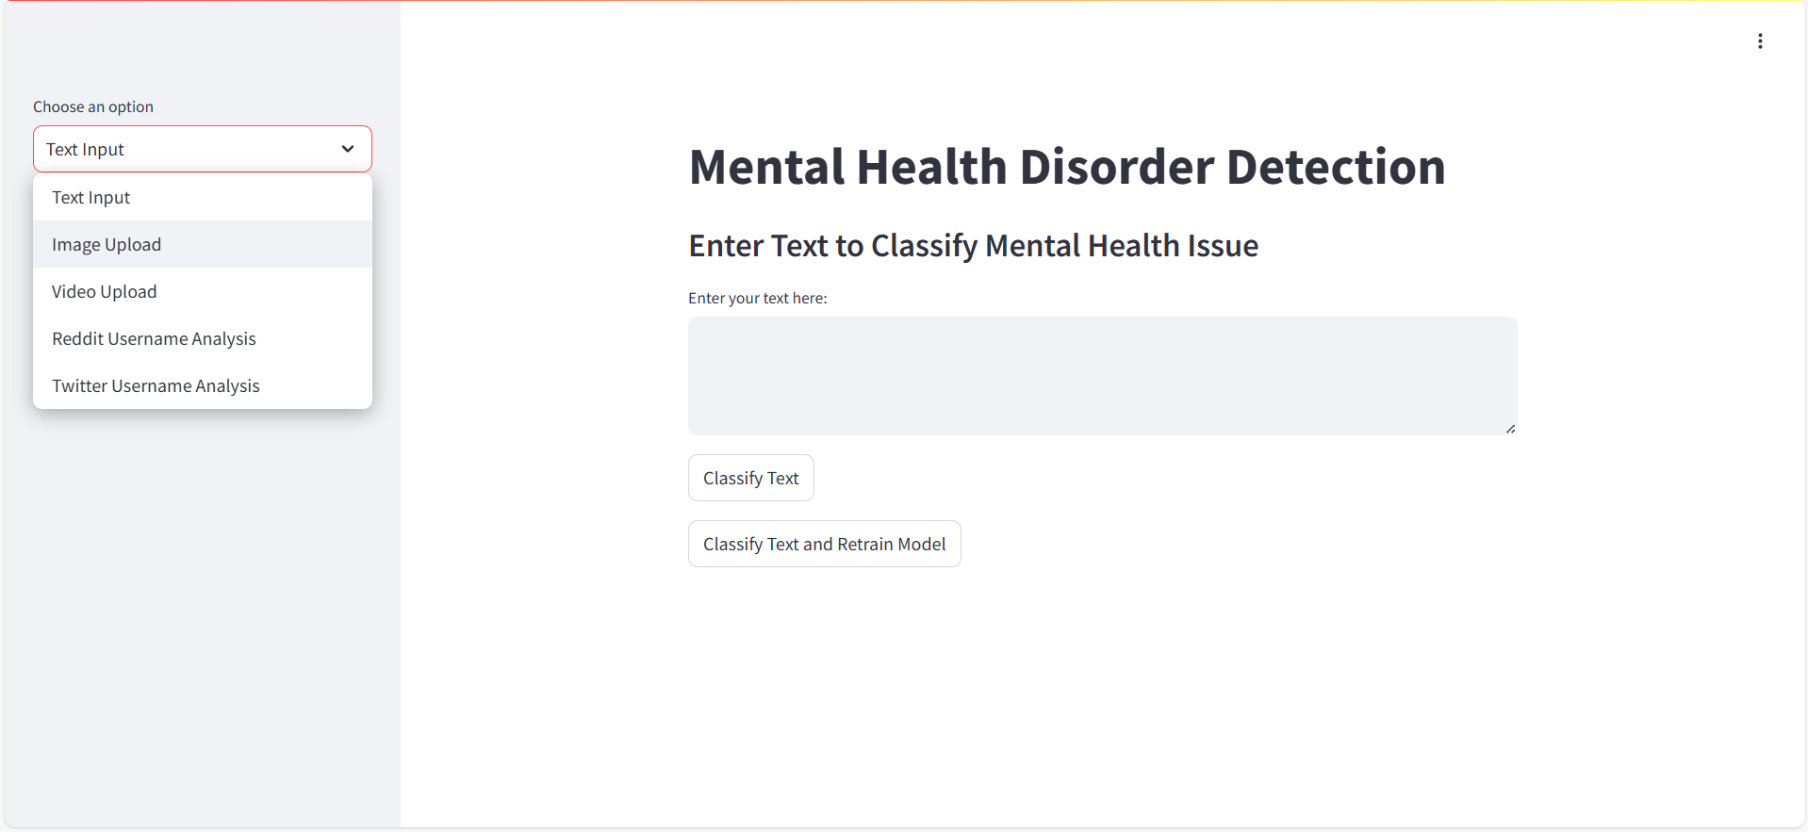
PROTOTYPE (CONTINUED)
GR29 ANALYZING SOCIAL MEDIA POSTS FOR MENTAL HEALTH DISORDER DETECTION
WEB APPLICATION INTERFACE

Slide 22
CONCLUSION
GR29 ANALYZING SOCIAL MEDIA POSTS FOR MENTAL HEALTH DISORDER DETECTION
Significance of the Project Developed a robust system for early detection of mental health disorders through social media analysis.
Effective Use of Machine Learning Leveraged various machine learning models, identifying SVM as the most accurate for sentiment classification.
Impact on Mental Health Awareness Provides valuable insights for mental health professionals and public health organizations, enabling proactive interventions.
Potential for Future Development Future enhancements with deep learning and multimodal data can lead to even better accuracy and insights.
Commitment to Ethical Practices Emphasizes the importance of user privacy and ethical considerations in handling sensitive mental health data.

Slide 23
REFERENCES
GR29 ANALYZING SOCIAL MEDIA POSTS FOR MENTAL HEALTH DISORDER DETECTION
Choudhury, M. D., De, S., & Counts, S. (2013). Predicting Depression via Social Media. Proceedings of the 7th International Conference on Weblogs and Social Media.
Guntuku, S. C., Bollen, J., & Lazer, D. (2017). Detecting Mental Illness in Social Media. American Journal of Public Health, 107(8), 1279-1285.
Mathur, P., Kharat, M., & Patil, S. (2022). Machine Learning Approaches for Mental Health Detection on Social Media: A Systematic Review. IEEE Access, 10, 14376-14388.
Nadeem, A. (2016). A Study of Depression Identification on Twitter. International Journal of Computer Applications, 141(10), 24-28.
AlSagri, A., & Ykhlef, M. (2020). A Machine Learning-based Approach for Depression Detection in Social Media. Journal of King Saud University - Computer and Information Sciences, 32(1), 60-66.
Vaishnavi, A., Rani, A., & Narayan, M. (2022). Application of Machine Learning Algorithms for Mental Health Prediction. International Journal of Data Science and Analytics, 12(2), 175-192.
Safa, M., Alshahrani, S., & Abunadi, M. (2023). Ethical Considerations in Predicting Mental Health from Social Media: A Roadmap for Future Research. Ethics and Information Technology, 25(1), 15-29.

Slide 24
GR29 ANALYZING SOCIAL MEDIA POSTS FOR MENTAL HEALTH DISORDER DETECTION
THANK YOU

